Slide 1
NV Center Optimization gate
김도겸

Slide 2
Purpose of study
Given the density matrix of the quantum state, predict theta value rotated by x gate and the phi value rotated by z gate.
Find the difference between the initial state and target state.
Notes:
양자 상태의 밀도 행렬이 주어지면 x 게이트에 의해 회전하는 세타 값과 z 게이트에 의해 회전하는 파이 값을 예측한다
예측 값과 실제 값의 차이를 찾습니다.

Slide 3
Contents of study
Obtain an optimization algorithm with less error between the predicted and actual values.
Measuring the algorithm’s operating time, seek a way to make benefit in time versus error.
Analyze how much error should be recognized within the allowable range by statistically.
Notes:
예측값과 실제 값 사이의 오차가 적은 최적화 알고리즘을 구한다
알고리즘 작동 시간을 측정하여 오차 대비 시간적으로 이익을 얻을 수 있는 방안을 모색한다.
어느 정도의 오차를 허용 범위 내로 인식해야 하는지를 통계적으로 분석해본다.

Slide 4
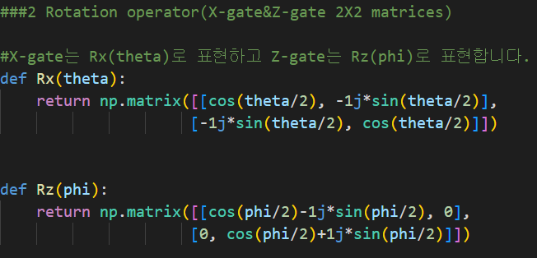
the way program works
Use function of the x gate that works when theta is entered and the z gate that works when phi is entered.
Set a bound of result values theta(0~ℼ) and phi(0~2ℼ) and make a random variable as an initial values.
Notes:
결과값(theta, phi)에 0~ℼ, 0~2ℼ까지의 범위를 지정하고, 무작위 변수를 초기값으로 입력한다.

Slide 5
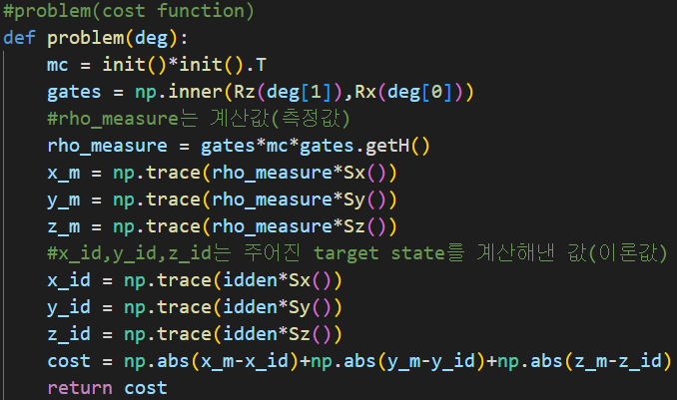
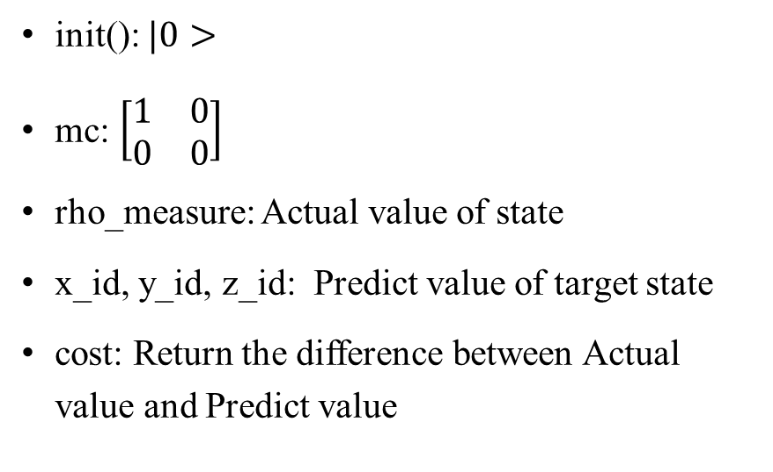
Objective function
init(): $|0>$
mc: $\left[\begin{matrix}1 & 0 \\ 0 & 0\end{matrix}\right]$
rho_measure: Actual value of state
x_id, y_id, z_id: Predict value of target state
cost: Return the difference between Actual value and Predict value

Slide 6
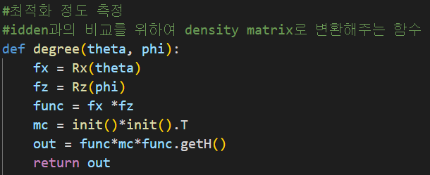
Objective function
idden: Randomly generated density matrix
degree: Change the values of theta and phi to density matrix for compare with idden matrix.

Slide 7
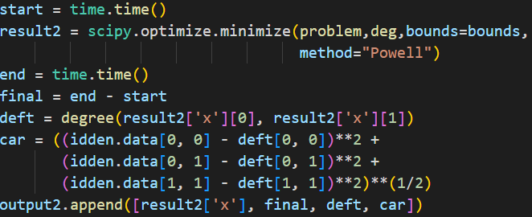
Objective function
start, end, final: Check times to find the computational time of the algorithm
deft: Change minimized result values(theta and phi) to density matrix
car: Calculate error

Slide 8
Algorithms used
Local optimization
Nelder-Mead
Powell
Global optimization
Differential_
evolution
Dual_annealing
In the case of Local optimization, we used the Powell, Nelder-Mead, COBYLA, SLSQP, trust-constr, BFGS, TNC, CG, dogleg method, and the Powell and Nelder-Mead method had the best minimized performance.
In the case of Global optimization, differential_evolution, shgo, dual_annealing, and direct methods were used, and differential_evolution, dual_annealing methods had the best minimized performance.
Notes:
Local optimization의 경우에는 powell, Nelder-Mead, COBYLA, SLSQP, trust-constr, BFGS, TNC, CG, dogleg 방식을 사용하였고, powell 과 Nelder-Mead 방식이 가장 minimized 성능이 가장 좋았습니다.
Global optimization의 경우에는 powell, Nelder-Mead, COBYLA, SLSQP, trust-constr, BFGS, TNC, CG, dogleg 방식을 사용하였고, powell 과 Nelder-Mead 방식이 가장 minimized 성능이 가장 좋았습니다.

Slide 9
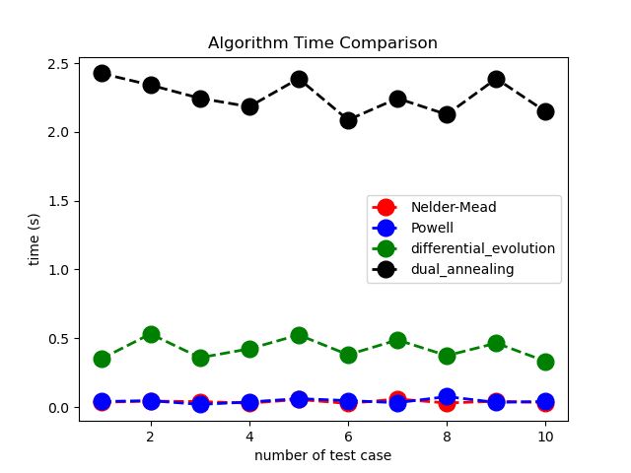
Algorithm time comparison
On average, Local optimizations are faster than Global optimizations.
Differential_evolution is faster than dual_annealing.
Overall, there was no significant difference between Nelder-Mead and Powell.

Slide 10
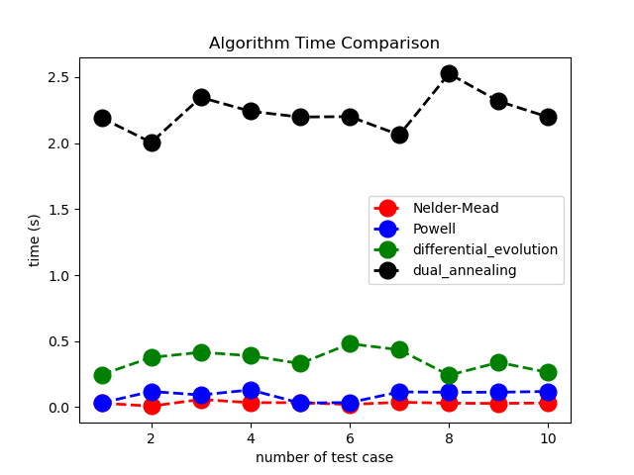
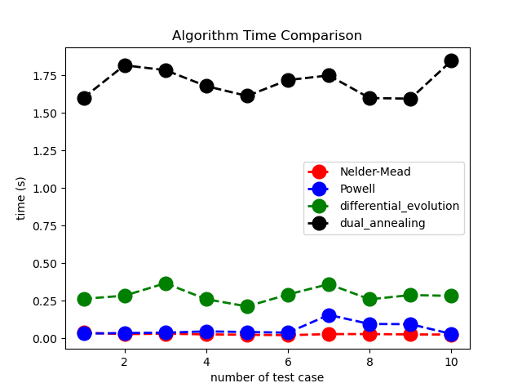
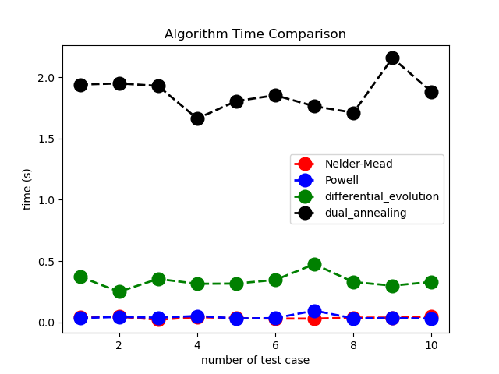
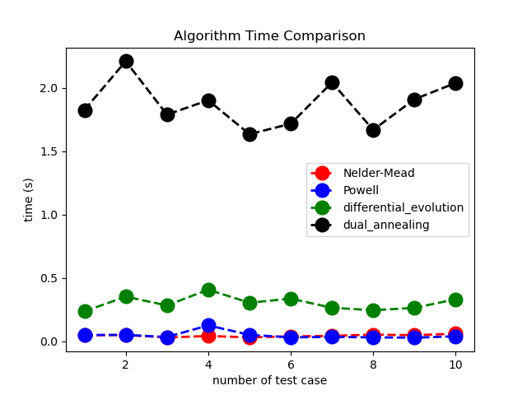
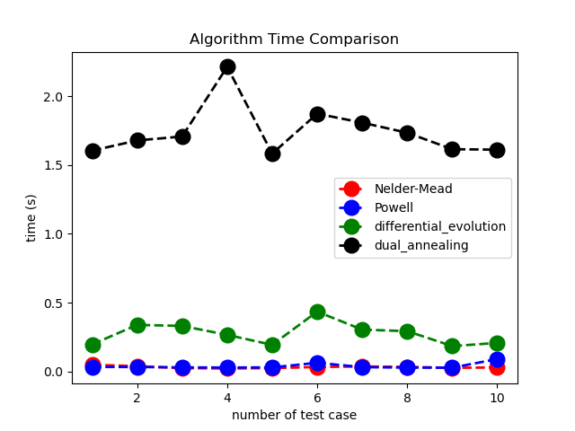
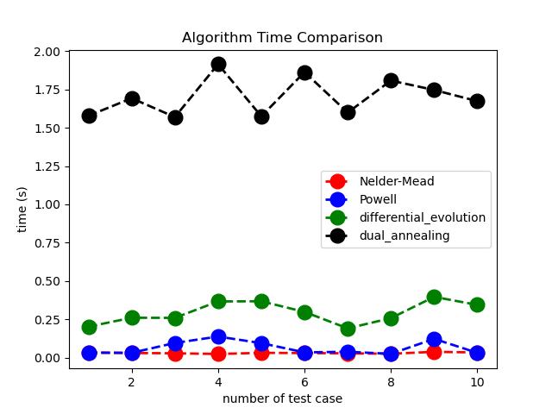
Algorithm time comparison

Slide 11
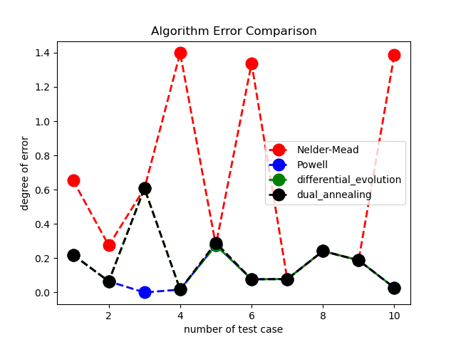
Algorithm Error comparison
Powell method shows the most stable optimization value.
Differential_evolution has some cases where optimization value was fast due to a slight difference.
The Nelder-Mead method often has incomplete optimization values, but often has better optimization values than other methods.

Slide 12
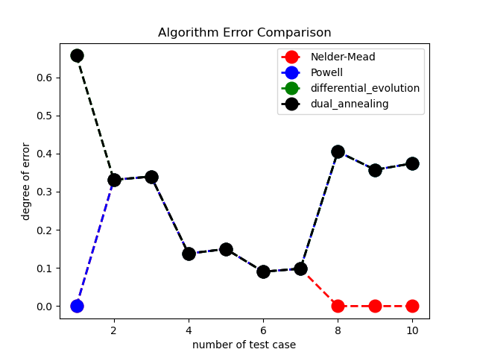
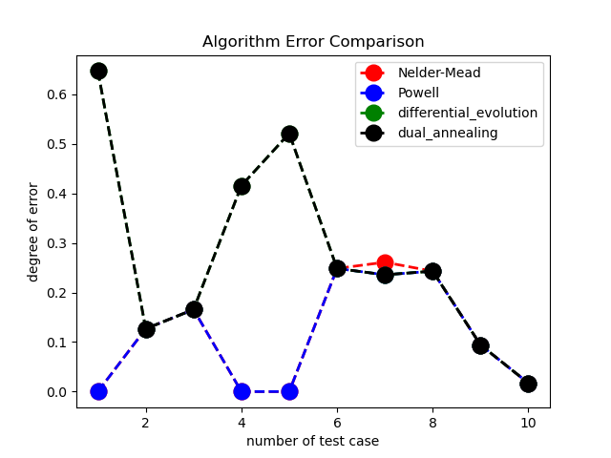
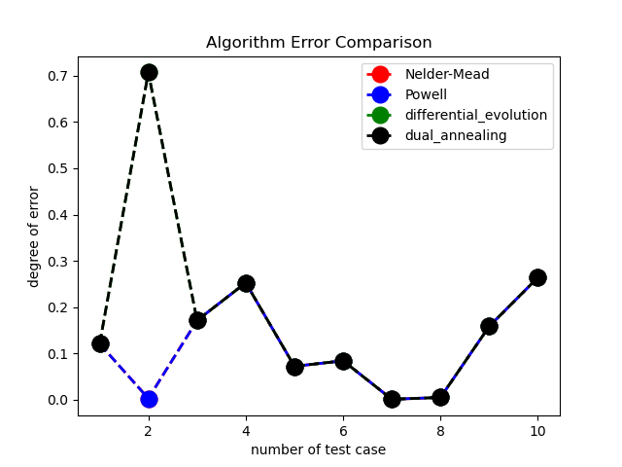
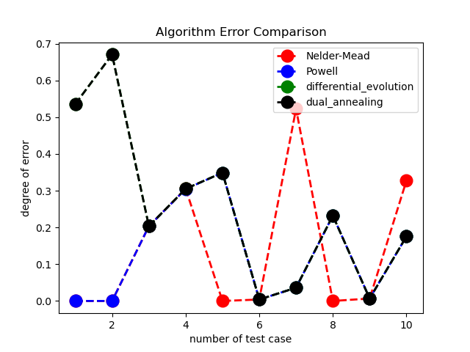
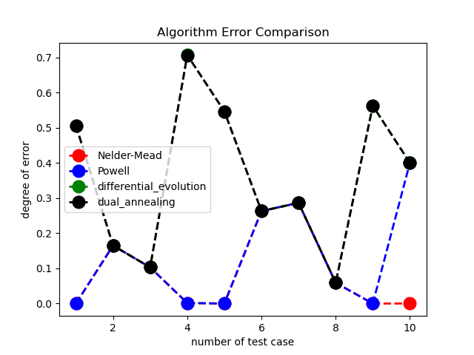
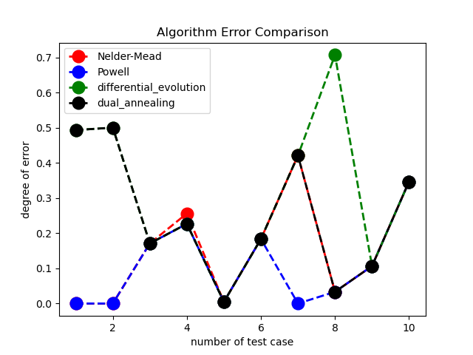
Algorithm Error comparison

Slide 13
Plan view
Powell
Nelder_Mead
Differential_evolution
Use the most reliable Powell method first.
If the reference value is not exceeded, measure the optimization value using the Nelder-Mead method.
If Nelder-Mead method also not exceeded, uses differential_evolution and find minimum value among the tree optimized values.

Slide 14
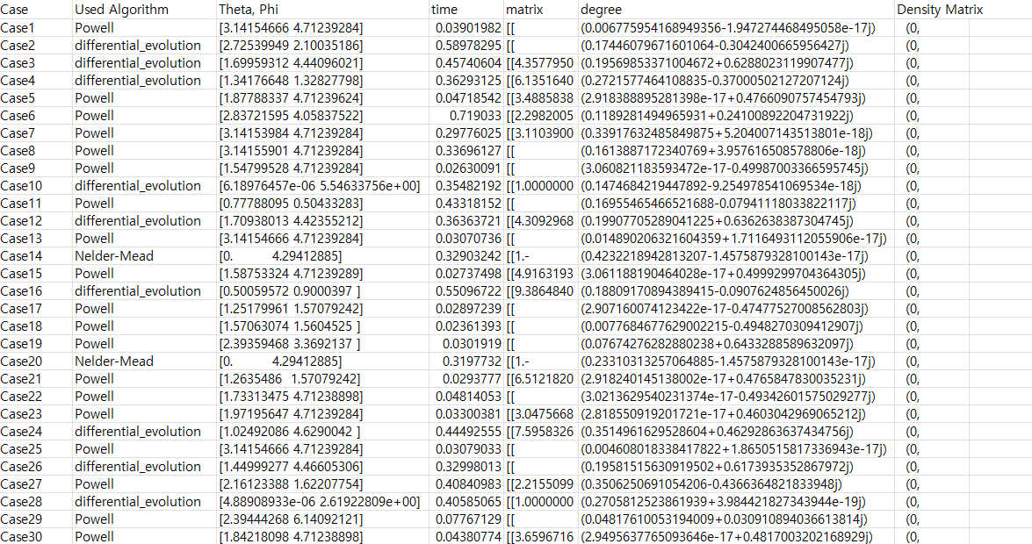

Result
Result_20230116_133002

Slide 15
Result

Slide 16
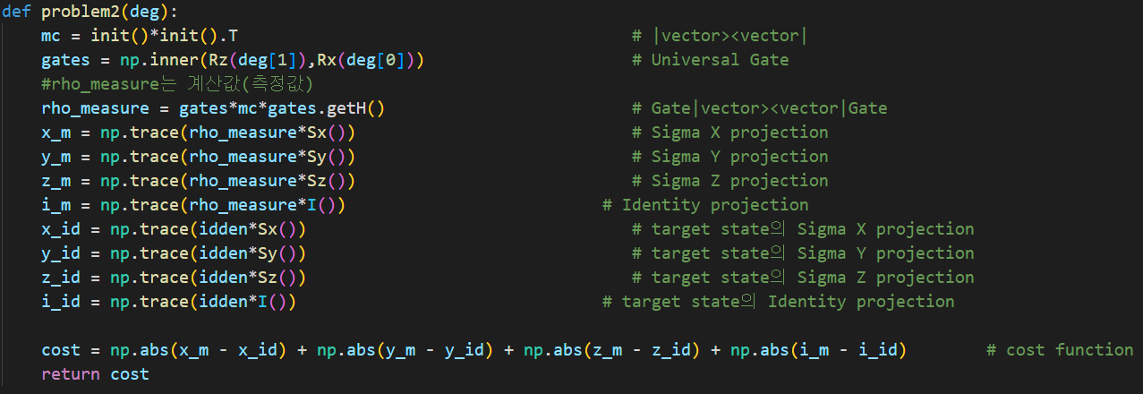
Objective function

Slide 17
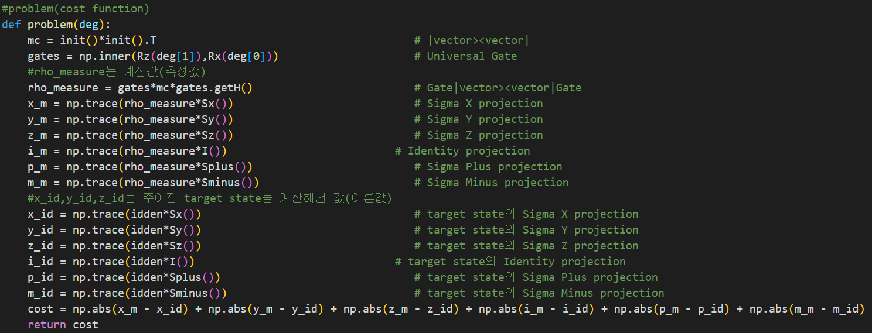
Objective function

Slide 18
Result

